Slide 1
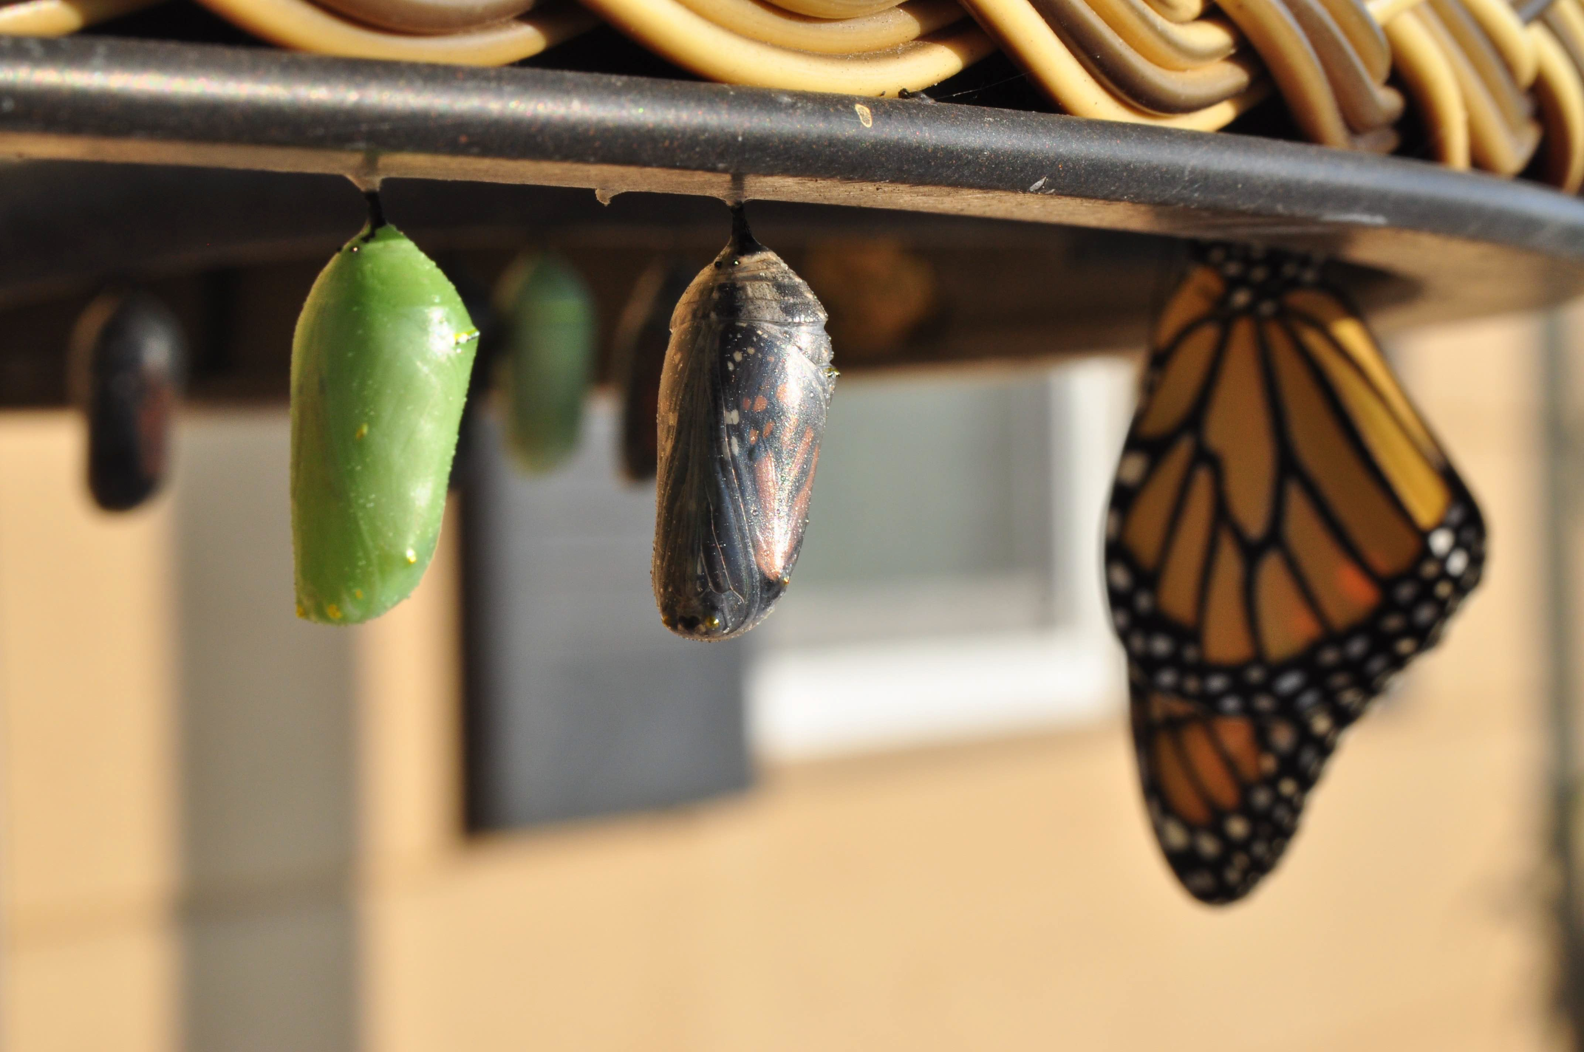
Introduction to Modern Controls
Inverse Laplace transform
Inverse Laplace Transform

Slide 2
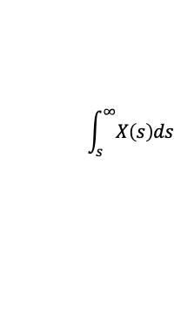
Common Laplace transform pairs
f(t)
F(s)
f(t)
F(s)
1
ω
_{s}2
_{e}−at
t _{t}2
_{te}−at
e^{−at} sin (ωt) e^{−at} cos (ωt)
sin ωt
cos ωt
tx (t) −^{dX (s)}
ds
_{t}
x(t)
δ (t) 1
1 (t)
2
+_{s} ω
s + a
1
s² + ω²
_{s}2
2
_{s}3
$$\int_{s}^{∞}{X\left(s\right)ds}$$
1
(s + a)²
ω
(s + a)² + ω²
1
s
s + a
(s + a)² + ω²
Laplace Transform

Slide 3

Overview of inverse Laplace transform: modularity and decomposition
goal: to break a large Laplace transform into small blocks, so that we can use elemental examples of Laplace transfer functions:
we will use examples to demonstrate strategies for common fractional expansions
$$G\left(s\right)=\frac{B\left(s\right)}{A\left(s\right)}=\frac{B_{1}\left(s\right)}{A_{1}\left(s\right)}+\frac{B_{2}\left(s\right)}{A_{2}\left(s\right)}+…$$
Inverse Laplace Transform

Slide 4
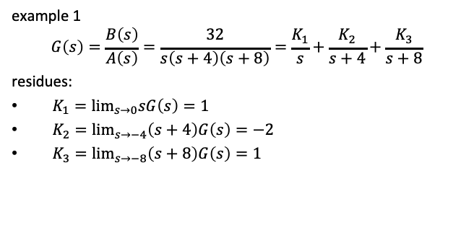
Real and distinct roots in A(s)
example 1
$$G\left(s\right)=\frac{B\left(s\right)}{A\left(s\right)}=\frac{32}{s\left(s+4\right)\left(s+8\right)}=\frac{K_{1}}{s}+\frac{K_{2}}{s+4}+\frac{K_{3}}{s+8}$$
residues:
$K_{1}=\lim_{s→0}sG\left(s\right)=1$
$K_{2}=\lim_{s→−4}\left(s+4\right)G\left(s\right)=−2$
$K_{3}=\lim_{s→−8}\left(s+8\right)G\left(s\right)=1$
Inverse Laplace Transform

Slide 5
Coding partial fraction expansions
% MATLAB
syms s
G = 32/s/(s+4)/(s+8) partfrac(G)
# Python import sympy
s = sympy.symbols('s') G = 32/s/(s+4)/(s+8) print(sympy.apart(G))
1/(s + 8) - 2/(s + 4) + 1/s
Inverse Laplace Transform

Slide 6
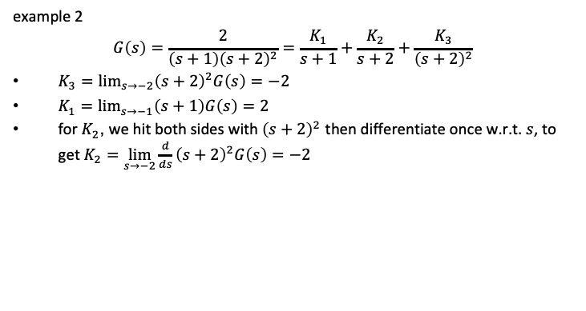
Real and repeated roots in A(s)
example 2
$$G\left(s\right)=\frac{2}{\left(s+1\right){\left(s+2\right)}^{2}}=\frac{K_{1}}{s+1}+\frac{K_{2}}{s+2}+\frac{K_{3}}{{\left(s+2\right)}^{2}}$$
$K_{3}=\lim_{s→−2}{\left(s+2\right)}^{2}G\left(s\right)=−2$
$K_{1}=\lim_{s→−1}\left(s+1\right)G\left(s\right)=2$
for $K_{2}$, we hit both sides with ${\left(s+2\right)}^{2}$ then differentiate once w.r.t. $s$, to get$K_{2}=\lim_{s→−2}\frac{d}{ds}{\left(s+2\right)}^{2}G\left(s\right)=−2$
Inverse Laplace Transform

Slide 7
Coding partial fraction expansions
# Python import sympy
s = sympy.symbols('s') G = 2/(s+1)/(s+2)**2 print(sympy.apart(G))
-2/(s + 2) - 2/(s + 2)**2 + 2/(s + 1)
Inverse Laplace Transform

Slide 8
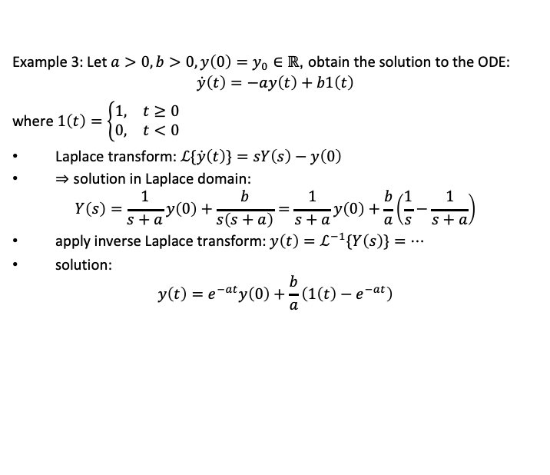
Solution of a first-order ODE
Example 3: Let $a>0,b>0,y\left(0\right)=y_{0}∈ℝ$, obtain the solution to the ODE:
$$\dot{y}\left(t\right)=−ay\left(t\right)+b1\left(t\right)$$
where $1\left(t\right)=\left\{\begin{matrix}1, & t≥0 \\ 0, & t<0\end{matrix}\right.$
Laplace transform: $ℒ\{\dot{y}\left(t\right)\}=sY\left(s\right)−y\left(0\right)$
$⇒$ solution in Laplace domain:
$$Y\left(s\right)=\frac{1}{s+a}y\left(0\right)+\frac{b}{s\left(s+a\right)}=\frac{1}{s+a}y\left(0\right)+\frac{b}{a}\left(\frac{1}{s}−\frac{1}{s+a}\right)$$
apply inverse Laplace transform: $y\left(t\right)=ℒ^{−1}\{Y\left(s\right)\}=…$
solution:
$$y\left(t\right)=e^{−at}y\left(0\right)+\frac{b}{a}\left(1\left(t\right)−e^{−at}\right)$$
Inverse Laplace Transform

Slide 9
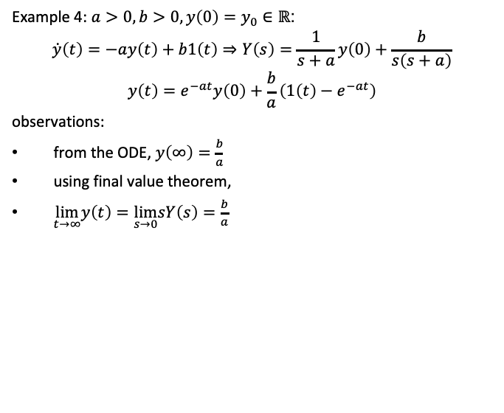
Solution of a first-order ODE
Example 4: $a>0,b>0,y\left(0\right)=y_{0}∈ℝ$:
$$\dot{y}\left(t\right)=−ay\left(t\right)+b1\left(t\right)⇒Y\left(s\right)=\frac{1}{s+a}y\left(0\right)+\frac{b}{s\left(s+a\right)}$$
$$y\left(t\right)=e^{−at}y\left(0\right)+\frac{b}{a}\left(1\left(t\right)−e^{−at}\right)$$
observations:
from the ODE, $y\left(∞\right)=\frac{b}{a}$
using final value theorem,
$\lim_{t→∞}y\left(t\right)=\lim_{s→0}sY\left(s\right)=\frac{b}{a}$
Inverse Laplace Transform

Slide 10
Solution of a first-order ODE
Example: Let a > 0, b > 0, y(0) = y₀ ∈ R, obtain the solution to the ODE:
y˙(t) = −ay(t) + bδ(t)
Laplace transform: L{y˙(t)} = sY(s) − y₀
⇒ solution in Laplace domain: Y(s) = _{s} ¹ (y₀ + b)
+a
apply inverse Laplace transform: y(t) = L⁻¹{Y(s)} = e^{−at}(y₀ + b)
Q: what’s the initial value from initial value theorem? what does the impulse do to the initial condition?
Inverse Laplace Transform

Slide 11
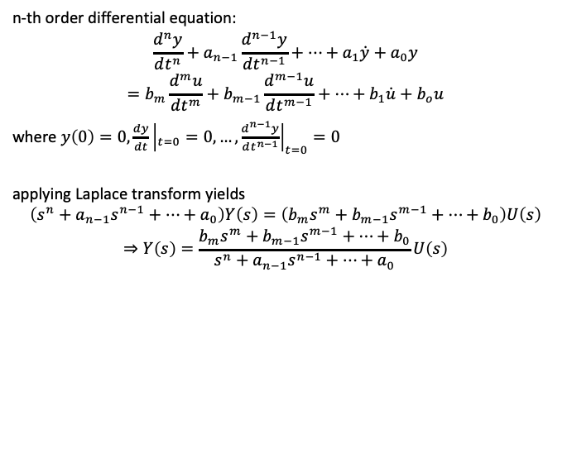
Connecting two domains
n-th order differential equation:
$$\frac{d^{n}y}{dt^{n}}+a_{n−1}\frac{d^{n−1}y}{dt^{n−1}}+⋯+a_{1}\dot{y}+a_{0}y=b_{m}\frac{d^{m}u}{dt^{m}}+b_{m−1}\frac{d^{m−1}u}{dt^{m−1}}+⋯+b_{1}\dot{u}+b_{o}u$$
where $y\left(0\right)=0,\frac{dy}{dt}{\left|​_{t=0}=0,…,\frac{d^{n−1}y}{dt^{n−1}}\right|}_{t=0}=0$
applying Laplace transform yields
$$\left(s^{n}+a_{n−1}s^{n−1}+…+a_{0}\right)Y\left(s\right)=\left(b_{m}s^{m}+b_{m−1}s^{m−1}+…+b_{0}\right)U\left(s\right)$$
$$⇒Y\left(s\right)=\frac{b_{m}s^{m}+b_{m−1}s^{m−1}+…+b_{0}}{s^{n}+a_{n−1}s^{n−1}+…+a_{0}}U\left(s\right)$$
Inverse Laplace Transform

Slide 12

Transfer functions
$$G\left(s\right)=\frac{Y(s)}{U(s)}=\frac{b_{m}s^{m}+b_{m−1}s^{m−1}+…+b_{0}}{s^{n}+a_{n−1}s^{n−1}+…+a_{0}}$$
A(s) = 0: characteristic equation (C.E.) roots of C.E.: poles of G(s)
roots of B(s) = 0: zeros of G(s) m ≤ n: realizability condition G(s) is called
▶ proper if n ≥ m
▶ strictly proper if n > m
examples: G₁(s) = K, G₂(s) = _{s} ^{k}
+a
Inverse Laplace Transform

Slide 13
Coding transfer functions in Python
import control as co
import matplotlib.pyplot as plt import numpy as np
num = [1,2] # Numerator co-efficients den = [1,2,3] # Denominator co-efficients sys_tf = co.tf(num,den)
print(sys_tf)
poles = co.pole(sys_tf) zeros = co.zero(sys_tf)
print('\nSystem Poles = ', poles, '\nSystem Zeros = ', zeros)
T,yout = co.step_response(sys_tf) plt.figure(1,figsize = (6,4)) plt.plot(T,yout)
plt.grid(True) plt.ylabel("y")
plt.xlabel("Time (sec)") plt.show()
Inverse Laplace Transform

Slide 14
Coding transfer functions in Python
import control as co
import matplotlib.pyplot as plt import numpy as np
num = [1,2] # Numerator co-efficients den = [1,2,3] # Denominator co-efficients sys_tf = co.tf(num,den)
T,yout = co.step_response(sys_tf)
u1 = np.full((1,len(T)),2) # Create an array of 2's u2 = np.sin(T)
T,yout_u1 = co.forced_response(sys_tf,T,u1) # Response to input 1 T,yout_u2 = co.forced_response(sys_tf,T,u2) # Response to input 2
Inverse Laplace Transform

Slide 15

The DC gain
$$G\left(s\right)=\frac{Y(s)}{U(s)}=\frac{b_{m}s^{m}+b_{m−1}s^{m−1}+…+b_{0}}{s^{n}+a_{n−1}s^{n−1}+…+a_{0}}$$
DC gain: the ratio of a stable system’s output to its input after all transients have decayed
can use the Final Value Theorem to find the DC gain:
$$DC gain of G(s) = \lim_{s→0}{sY\left(s\right)=\lim_{s→0}{sG\left(s\right)\frac{1}{s}}=\lim_{s→0}{G(s)}}$$
example: find the DC gain of G₁(s) = K and G₂(s) = _{s} ^{k} . Try (i)
+a
solve the ODE and (ii) the Final Value Theorem
Inverse Laplace Transform

Slide 16
The DC gain in Matlab and Python
% MATLAB
s = tf('s');
G = (2*s+3)/(4*s^2+3*s+1); dcgain(G)
# Python
import control as co s = co.tf('s')
G = (2*s+3)/(4*s**2+3*s+1); print(co.dcgain(G))
Inverse Laplace Transform

Slide 17
The DC gain in Matlab and Python
find the DC gain of the system corresponding to Y₂(s) = _{s} ³
−2
# Python
import control as co
H = co.tf([0, 3],[1, -2])
print(co.dcgain(H))
T, yout = co.step_response(H) print(yout)
exercise: verify the result in Matlab is the result correct?
Inverse Laplace Transform

